Slide 1
INCREMENTAL IRR

Slide 2
IRR Misconcepts
Ranking alternatives by individual IRR
Ranking alternatives by individual IRR values can give conflicting results when ranking is done based on PW method.
This is evident from the following example.

Slide 3
Why Must Incremental Analysis be Used for Competing Projects?
Assume that an MARR of 16% per year is required, and $85000 is available to invest:
Project A requires $50000 upfront to obtain an IRR of 35% per year.
Project B requires an $85000 first cost and returns an IRR of 29% per year.
What could we do with the un-invested money from Project A? ($35000)
Notes:
A decision-making technique used in business to determine the true cost difference between alternatives.

Slide 4
Why Must Incremental Analysis be Used for Competing Projects?
It would be reasonable to invest the remaining $35000 at the MARR:
Overall IRR_{A} = 50 000(0.35) + 35 000(0.16)
85000
= 27.2% per year
Project B returns an IRR of 29% per year on ALL the money available to invest.

Slide 5
Comparing Mutually Exclusive Alternatives Based on IRR
Issue: Can we rank the mutually exclusive projects by the magnitude of its IRR?
n A1 A2
0
1
IRR
-$1,000 -$5,000
$2,000 $7,000
100% > 40%
$818 < $1,364
PW (10%)
Notes:
When two or more mutually exclusive alternatives are evaluated, engineering economy can identify the one alternative that is the best economically.

Slide 6
Incremental Analysis (Procedure)
Step 1: Compute the cash flow for the difference between the projects (A,B) by subtracting the cash flow of the lower investment cost project (A) from that of the higher investment cost project (B).
Step 2: Compute the IRR on this incremental investment (IRR ).
Step 3: Accept the investment B if and only if
IRR _{B-A} > MARR
B-A
NOTE: Make sure that both IRR_{A} and IRR_{B} are greater than MARR.

Slide 7
A tool and die company in Pittsburgh is considering the purchase of a drill press with fuzzy-logic software to improve accuracy and reduce tool wear. The company has the opportunity to buy a slightly used machine for $15,000 or a new one for $21 ,000. Because the new machine is a more sophisticated model, its operating cost is expected to be $7000 per year, while the used machine is expected to require $8200 per year. Each machine is expected to have a 25-year life with a 5% salvage value. Tabulate the incremental cash flow and identify the best alternative, by taking MARR = 15%.

Slide 8
You are considering two projects for investment, and you can only invest in one:
You have $30 in capital and any funds you do not invest in these projects may be invested elsewhere at the MARR of 6%. Which should you choose?
Year | A | B
0 | -10 | -20
1 | 15 | 28

Slide 9
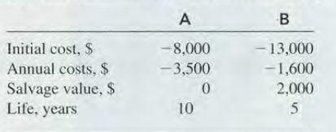
In 2000, Bell Atlantic and GTE merged to form a giant telecommunications corporation named Verizon Communications. As expected, some equipment incompatibilities had to be rectified, especially for long distance and international wireless and video services. One item had two suppliers - a U.S. firm (A) and an Asian firm (B). Estimates for vendors A and B are given for each unit. Determine which vendor should be selected if the MARR is 15% per year. Using Incremental IRR

Slide 10
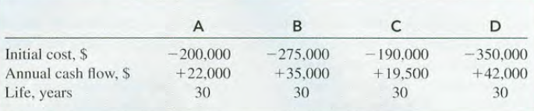
Caterpillar Corporation wants to build a spare parts storage facility in the Phoenix, Arizona, vicinity. A plant engineer has identified four different location options. Initial cost of earthwork and prefab building, and annual net cash flow estimates are given. The annual net cash flow series vary due to differences in maintenance, labor costs, transportation charges, etc. If the MARR is 10%, use incremental ROR analysis to select the one economically best location.
IRR: C = 9.63% A = 10.49% B = 17.28% D = 8.55%

Slide 11
ABC Corporation is considering two types of manufacturing systems to produce its
shaft couplings over six years: (1) a cellular manufacturing system (CMS) and (2) a
flexible manufacturing system (FMS). The average number of pieces to be produced
with either system would be 544,000 per year. The operating cost, initial investment,
and salvage value for each alternative are estimated as follows:

Slide 12
You are considering two types of automobiles. Model A costs $18,000 and Model B costs $15,624. Although the two models are essentially the same, after 4 years of use Model A can be sold for $9,000, while Model B can be sold for $6,500. Model A commands a better resale value because its styling is popular among young college students. Determine the rate of return on the incremental investment of $2,376. For what range of values of your MARR is model A preferable?

Slide 13
For MARR of 6% and each alternative having a life of 20 years with no salvage value and cost information as shown in table below. Which Alternative is preferred? Use Incremental IRR method.
 | A | B | C
Initial Costs, $ | 2000 | 4000 | 5000
Uniform annual benefit, $/year | 410 | 639 | 700

